Slide 1
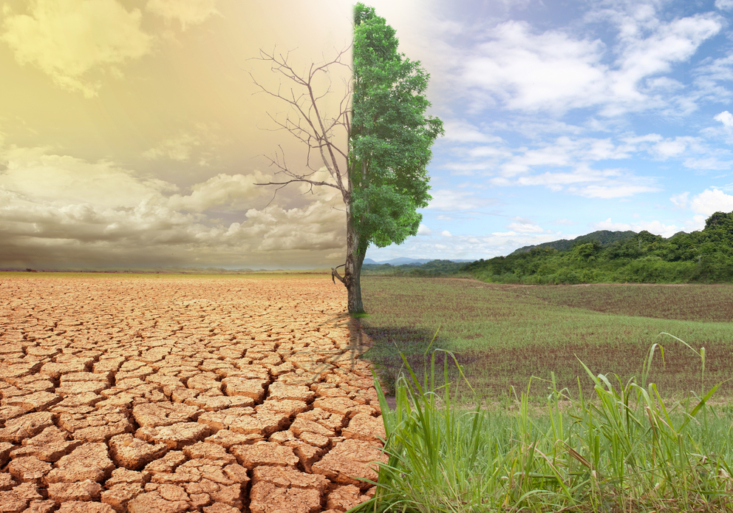
In
DESERT TECHNOLOGY XV (DT XV)
INTERNATIONAL CONFERENCE ON ARID LAND
3-6 June 2023, Dead Sea, Jordan.
TITLE
Co-author 1 name ¹; Co-author 2 name ²
¹ Affiliation 1, contact details; ²Affiliation 2, contact details
INTRODUCTION
Sample Layout for 80x120 cm poster: Keep it simple,
This example is to demonstrate the layout of an example poster for presentation at the WMAL2017. The purpose of a poster paper presentation is to promote informal discussion. It is a graphic display of a written manuscript. The poster presentation stands by itself as a summary of research and usually contains an overview of research objectives, experimental methods, materials, results and a discussion. Often, in poster presentations, a clear message in less words is more effective.
METHODS
DISCUSSION
The key message is: An interested individual who is not necessarily familiar with your field of expertise should be able to follow your poster. The purpose of poster paper presentations is to promote informal discussion. To achieve your goal you’ll need to two things:
A clear message (imagine a poster as an illustrated abstract);
An attractive and clear layout.
This template is a tool you should use to make the best out of your poster. We provide the attractive layout and the guidance, you provide the content and the best of your work.
Each paragraph should have more than 2 sentences and less than 5 sentences. Each sentence shouldn’t have more than 30 words. Use bullet points whenever it is possible, your audience will read them and discuss them with you. Use figures to structure your message and to show your key findings.
Focus on the key questions you want to answer. Begin by answering the “Why?” are you working on this followed by, “What am I adding?”, “How? Methods”, “What did I find?” and “What do I recommend?”
The clear areas between paragraphs and chapters are valuable. A direct message presented using a clear structure is easier to read and will attract your audience [1].
Table 1 – How to build a table for a poster
Title
March | 3 | 5 | 3
April | 8 | 5 | 6
May | 4 | 10 | 9
June | 10 | 11 | 13
This table only shows key figures, it is light and easily understandable and self explanatory. The side box only gives some hints on what is in the table
Fill with text. Fill with text. Fill with text. Fill with text. Fill with text. Fill with text. Fill with text. Fill with text. Fill with text. Fill with text. Fill with text. Fill with text. Fill with text.
Fill with text. Fill with text. Fill with text. Fill with text. Fill with text. Fill with text. Fill with text. Fill with text. Fill with text. Fill with text. Fill with text. Fill with text. Fill with text. Fill with text. Fill with text. Fill with text. Fill with text. Fill with text. Fill with text. Fill with text. Fill with text. Fill with text.
This figure shows trends, it is light and easily understandable and self explanatory. The side box only gives some hints on what is in the figure.
Use figures to support your text. The average visitor will pay more attention to figures than to text, keep it short and simple.
RESULTS
Fill with text. Fill with text. Fill with text. Fill with text. Fill with text. Fill with text. Fill with text. Fill with text. Fill with text. Fill with text. Fill with text. Fill with text. Fill with text.
Fill with text. Fill with text. Fill with text. Fill with text. Fill with text. Fill with text. Fill with text. Fill with text. Fill with text. Fill with text. Fill with text. Fill with text. Fill with text. Fill with text. Fill with text. Fill with text. Fill with text. Fill with text. Fill with text. Fill with text. Fill with text. Fill with text.
Figure 2 – How to build a graph for a poster
The pictures are used to show key points of the research. You should use them but avoid resolution overkill, more than 150 dpi but less than 300 dpi.
Save photos as .jpg or png (graphs as png) and take into account that web images are usually poor resolution.
If the picture is not yours, acknowledge the intellectual property of it.
CONCLUSIONS
Finish with a brief conclusion. Summarise your findings and list the key points of your research.
Be brief and direct
This shows the outcome of all of your efforts
Figure 1 – How to insert a figure (source: IWA)
References: List your references here.
Acknowledgements: Use this box to acknowledge your partners and sponsors
DT XV
Dead Sea, Jordan 2023

